Slide 1

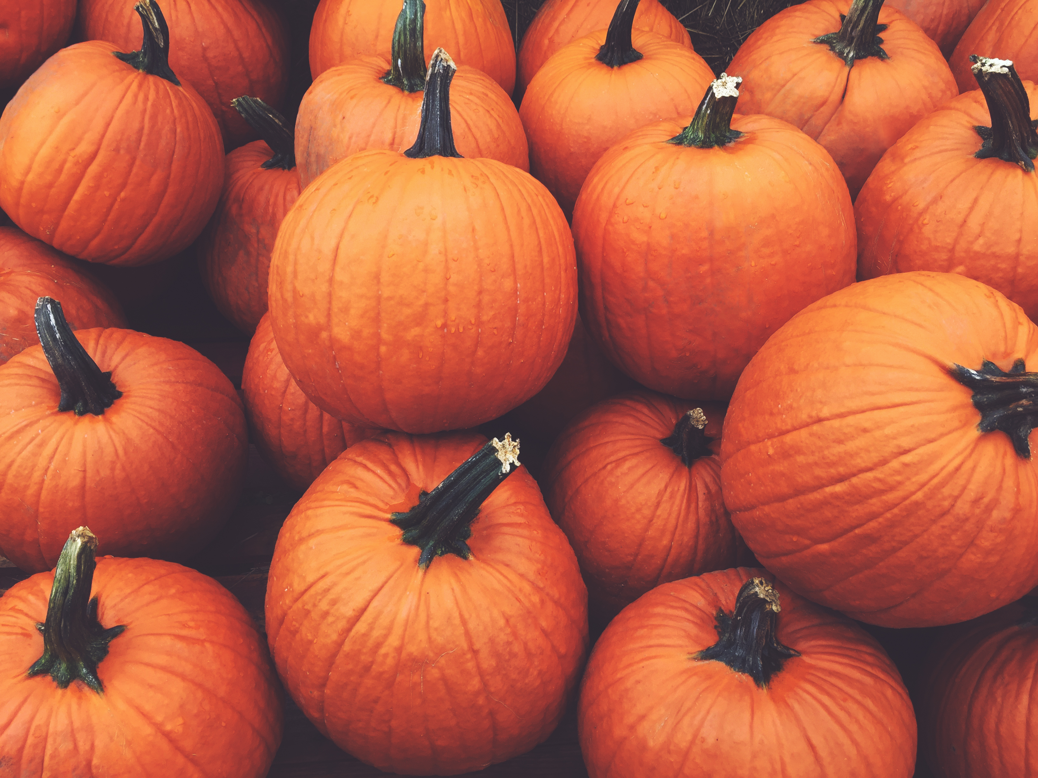
Kids Club Schedule – November 2026
Time
Sunday 24th
Monday 25th
Tuesday 26th
Wednesday 27th
Thursday 28th
Friday 29th
Saturday 30th
9:00 a.m. Thanksgiving Autum Art & Craft Nature Walk & Collect Leave Thankful Tree Craft Food-Themed Bingo Autum Leaf Stamping Pictionary
Coloring
10:00 a.m. Turkey Autum Leaf Rubbing Pinecone Turkey Craft Kindness Chain Project Pumpkin Pie Decorating Corn Relay Races Giant Jenga Hat Craft
11:00 a.m. Leaf Pile Build a Fall Wreath Musical Chairs Story Time: The Giving Story Cranberry Sensory Play Build-Your-Own Thanksgiving
Bean Bag Toss Scarecrow Trivia
12:00 p.m. Thanksgiving Thanksgiving Memory Mini Pumpkin Hunt Friendship Bracelets Pretend Play Kitchen Pumpkin Ring Toss Board Game Storytime Games Bonanza
1:00 p.m. L U N C H
2:00 pm Handprint Turkey Cornhole Toss Leaf Painting Gratitude Scavenger Hunt Cupcake Decorating Harvest Obstacles Relay Races Art Challenge Course
3:00 p.m. Fall Puzzle Time DIY Pilgrim Hat Thanksgiving Charades Group Thanksgiving Card Apple Stamp Art Pin the Hat on the Talent Show
Scarecrow
4:00 p.m. Gratitude Sharing Harvest Theme Bingo What I’m Thankful for Dance Party: Songs of Joy Thanksgiving Food Parade Thanksgiving Karaoke Thanksgiving Stone Circle November Painting
5:00 p.m. Pick Up Time Pick Up Time Pick up Time Pick up Time Pick up Time Pick up Time Pick up

Slide 2

Kids Club Schedule – 20th to 26th December 2026
Time
Sunday 20th
Monday 21st
Tuesday 22nd
Wednesday 23rd
Thursday 24th
Friday 25th
Saturday 26th
9:00 a.m. Welcome Craft Flag & Passport Craft Chef Hat & Apron Craft Decorate Christmas DIY Christmas Holiday Handprint Reindeer Games Ornament Cards
10:00 a.m. Limbo & Island Dance African Drumming Decorate your own Snowball Toss Christmas Scavenger Hunt Santa’s Gift Give Away Pin the Nose Games Circle Cupcake at the Lobby on Rudolph
11:00 a.m. Mocktail Station Caribbean Soca Dance Class Gingerbread Making Christmas Story Candy Cane Santa Gift Give Away Christmas Puzzle & Tasting Games at the Asiatique Restaurant Spoon Race At the Lobby
12:00 p.m. Tropical Treasure Hunt Dance Games Gingerbread Making Write Letters Christmas Coloring Christmas Christmas Story at the Asiatique Restaurant to Santa Station Bingo
1:00 p.m. L U N C H
2:00 pm Beach Ball Bonanza Latin Dance Hour Cookie Decorating Draw a Wish List Festive Fruit Kebabs Christmas Dance Party Christmas Talent Contest Show
3:00 p.m. Island Craft Workshop Creative Movement Smoothie Making Christmas Photo Carol Sing Along Kindness Project Elf Parade
Station Booth
4:00 p.m. Mini “Carnival” Dance Parade Mini MasterChef Christmas Christmas Tree Christmas Thank Notes \Party & Group Certificate Ceremony Movie Decorating Story Time to Santa
5:00 p.m. Pick Up Time Pick Up Time Pick up Time Pick up Time Pick up Time Pick up Time Pick up

Slide 3

Kids Club Schedule – December 27th 2026 to January 2nd 2027
Time
Sunday 27th
Monday 28th
Tuesday 29th
Wednesday 30th
Thursday 31st
Friday 1st
Saturday 2nd
9:00 a.m. DIY Snow Globes Popsicle Craft Christmas Stockings Santa Beard Craft Holiday Slime New Yrs Resolution Puzzle Time
10:00 a.m. Nativity Scene Craft Elf Training Course Christmas Story Snowman Fruit Cups Party Hat & Noise Maker Vision Boards Play Doh Ice Cream
11:00 a.m. Christmas Photo Frame Decor Musical Gift Christmas Trivia Jingle Bell Dance Memory Collage 2025 Pretend Kitchen Outdoor Play Play
12:00 p.m. Santa Relay Holiday Charades Holiday Movie Countdown Balloon prep Limbo Musical Play Story Time
1:00 p.m. L U N C H
2:00 pm Christmas Bowling Snowball fight Build Santa Village Carols Karaoke Musical Chairs Build a Fort Watercolor Paint
3:00 p.m. Candy Cane Hunt Thankful Notes Puzzle Race Drum & Shaker Old Year’s Ball Pit Play Slide and Play
Countdown Party
4:00 p.m. Wrap the Present Christmas Crossword Christmas Trail Mix Elf Freeze Glow Stick Dance & Treat Stone Painting Sensory Board Play
5:00 p.m. Pick Up Time Pick Up Time Pick up Time Pick up Time Pick up Time Pick up Time Pick up

Slide 4

Kids Club Schedule – January 3rd to 4th January 2026
Time
Monday 3RD
Tuesday 4TH
9:00 a.m. Kids Yoga Lawn Yoga
10:00 a.m. Leaf Art Pretend Play
11:00 a.m. Jellyfish Art Teddy Concert
12:00 p.m. Ball Play Slime Play
1:00 p.m. L U N C H
2:00 pm Tenns Balloon Play Stacking Cups
3:00 p.m. Story Time Play Doh Play
4:00 p.m. Movie Time Musical Chairs
5:00 p.m. Pick Up Time Pick Up Time

